Slide 1
IN2002 Data Structures and Algorithms
Lecture 2 – Priority Queues, Trees, Heaps and Queues
Dr Cristina Gacek
Term 1, 2025/26

Slide 2
Learning Objectives
Understand and be able to use:
the abstract data type priority queue and queue
the data structures:
Heaps
Extensible arrays
Be able to understand, apply and develop algorithms for those above, most notably:
Adding elements
Extracting elements
HeapSort

Slide 3
Priority Queues

Slide 4
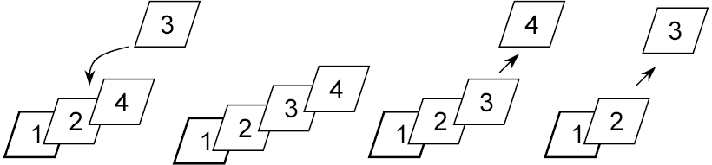
Priority Queues - Principle
You can only remove the element with the highest priority
Examples: printer queues, emergency rooms, council housing

Slide 5
Priority Queue Operations
Add an element
Remove an element: the element removed is the one with the highest priority
Check whether the queue is empty

Slide 6
Applications of Priority Queues
As a component of various algorithms
Sorting: add all the items to the priority queue and then extract them one by one
Scheduling (e.g. in operating systems, post, air traffic)
Event-driven simulation

Slide 7
Scheduling
Several tasks should be performed with different priorities
For example…
We want to produce a system for parcel deliveries. The priority could be set by using the guaranteed date of delivery and the time at which the parcel was posted.
The priority queue would be handled by storing the parcels in the depot and releasing them for delivery according to their priority.
In busy days, probably only those parcels whose delivery is due - i.e., those that have the highest priority - could be delivered.
In less busy days, parcels would be delivered in advance of their guaranteed date of delivery.

Slide 8
Event-Driven Simulation
We wish to simulate a series of events, each considered to occur at a point in simulated time.
Nothing happens between events, so maintain a collection of pending events, and repeat:
extract the first pending event
advance the simulation clock to its time
simulate the event
Events may change the state, and may cause other events at later times, i.e. add further events to the collection
Useful for load analysis and prediction
e.g., for Internet nodes, road or air traffic, emergency procedures.

Slide 9
A priority queue ADT
// A priority queue of integers
public interface PriorityQueue {
// Is the priority queue empty?
boolean isEmpty();
// Add an element to the priority queue
void add(int elt);
// Remove and return the largest value
// currently in the priority queue
int extractMax();
}

Slide 10
An implementation using a sorted array
A way of implementing priority queues is to keep the elements in a sorted array, so:
to add an element, search and insertion are used
to extract an element, the last element in the array is extracted (as it will have the highest priority)

Slide 11
Concrete Implementation in Java
public class ArrayPQ implements PriorityQueue {
private int[] data;
private int count = 0;
public ArrayPQ(int size){ data = new int[size]; }
public boolean isEmpty(){ return count == 0; }
public void add(int elt){
insert(data, count++, elt);
}
public int extractMax(){ return data[--count]; }
}

Slide 12
Analysing the use of the Data Structure & related basic operations
The data structure takes O(n) space complexity
By using the ordered array data structure:
isEmpty takes time O(??)
add takes time O(??)
extractMax takes time O(??)
The ordering constraint is very restrictive, maintaining it by insertions costs O(..) time.

Slide 13
An Alternative Implementation
What would happen if the representation were an unordered array?
In that case:
isEmpty takes time O(??)
add takes time O(??)
extractMax takes time O(??)
It is an equivalent situation, but slow at extracting.

Slide 14
Is there a better implementation?

Slide 15
Trees

Slide 16
What is this?

Slide 17
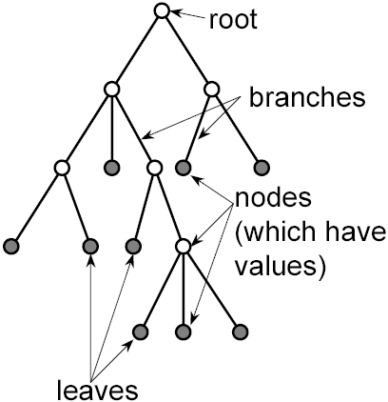
Quick introduction to trees
Trees are data structures that have a root, nodes, branches and leaves
Most nodes are at the end of a branch. The only exception is the root (which is the top node!)
Branches proceed from nodes
Nodes without branches are called “leaves”

Slide 18
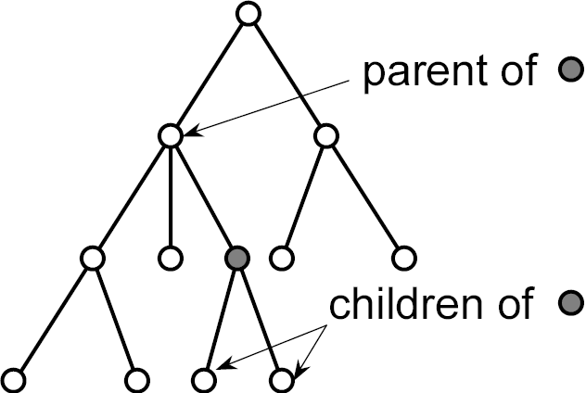
More tree terminology
The nodes n2,n3 at the end of a node n1’s branches are its children, and n1 is the parent of n2,n3.
The root is thus a node with no parents.
The leaves are nodes with no children.

Slide 19
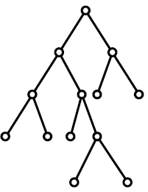
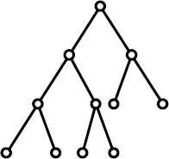
Tree types
A binary tree is a tree in which each node has, at most, two children
A perfectly balanced binary tree is a tree whose least deep leaf is no more
than one level apart from the deepest one

Slide 20
Just seen…
Priority queues
 | Ordered Array | Unordered Array
isEmpty
add
extractMax

Slide 21
Back to… Is there a better implementation for priority queues?
Using heaps (a kind of tree) we can distribute and
reduce the load, achieving O(log n) time for both add
and extractMax.
* Very briefly mentioned to you in Introduction to Algorithms

Slide 22
Heaps

Slide 23
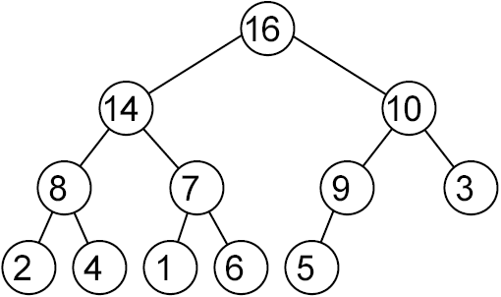
Heaps Invariants
A heap is a perfectly balanced binary tree such that:
No node is larger than its parent
All items on the lowest level are as far to the left as possible

Slide 24
Heap Operations
Heap is empty if the root is empty
Heap insertion: add a node to the heap—displacing other nodes as necessary so that the heap remains a heap
Heap extraction: remove the element with the highest value in the heap (the root), moving the other nodes as necessary so that the heap remains a heap

Slide 25
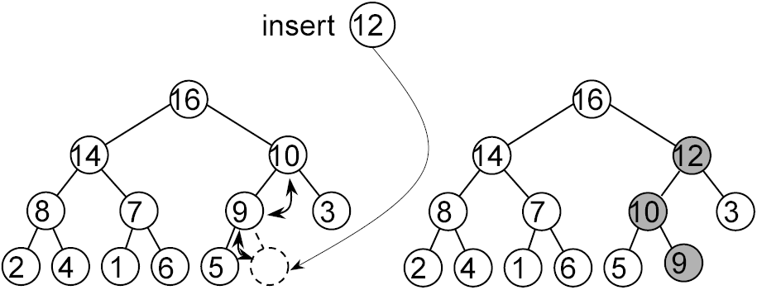
Heap Insertion
Add the new node as a leaf
Sift the new node up to its correct position (at most log n swaps—because the tree has at most log n levels)

Slide 26
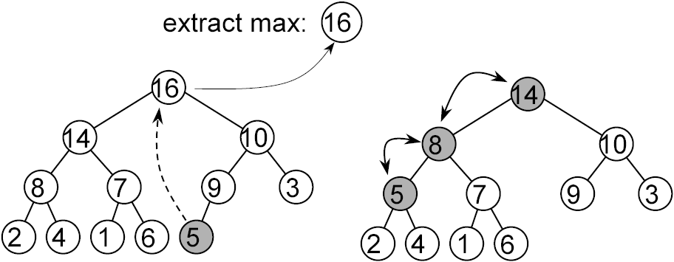
Heap Extraction
Extract the root, and place the last leaf in the root position
Re-establish the heap conditions (at most log n swaps)

Slide 27
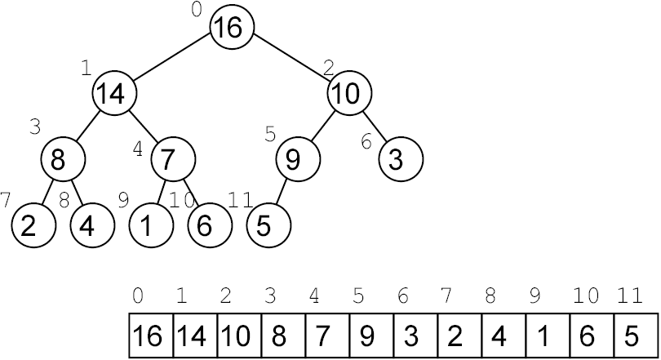
Heaps and Arrays
Heaps can be represented as arrays:

Slide 28
Relating indices
Notice that:
the parent of node n is node (n-1)/2 (int division)
the left child of node n is node 2n + 1
the right child of node n is node 2n + 2

Slide 29
An Implementation in Java
public class HeapPQ implements PriorityQueue {
private int[] data; // data[] is the heap
private int count = 0;
public HeapPQ(int size){data = new int [size];}
public boolean isEmpty(){return count == 0;}
... HeapPQ continues

Slide 30
Relating Indices in Java
You will remember that:
the parent of node n is node (n-1)/2
the left child of node n is node 2n + 1
the right child of node n is node 2n + 2
private int parent(int n) { return (n-1)/2; }
private int left(int n) { return n*2 + 1; }
private int right(int n) { return n*2 + 2; }
... HeapPQ continues

Slide 31
Heap Insertion
Function add(elt) where data is the array containing
the heap and count is the heap size:
pos ← count+1
WHILE pos > 1 AND data[parent of pos] < elt
data[pos] ← data[parent of pos]
pos ← parent of pos
data[pos] ← elt
count ← count + 1

Slide 32
Heap Extraction
Function extractMax() where “data” is the array containing the
heap and “count” is the heap size:
max ← data[1]
data[1] ← data[count]
count ← count - 1
moveDown(data, 1, count)
Return max
Function moveDown(data, first, last) moves the element at position first down to its proper position

Slide 33
Moving a key down the heap
Function moveDown(data, first, last):
WHILE position of left child of first <= last
larger ← position of the child of first with the larger value
IF data[first] >= data[larger] THEN
Break the while loop
swap contents in data between positions first and larger
first ← larger
Remember that first, larger and last are positions in array data. The value of larger, for example, is data[larger].

Slide 34
Sorting using heaps
Heap sort involves:
adding the elements to a heap, and then
extracting the elements from the heap
This could be done with just one array:
in the first phase, the heap grows as the unsorted section shrinks
in the second phase, the heap shrinks as the sorted portion grows.

Slide 35
HeapSort in Java
void heapsort(int[] data) {
\\ first phase: heap goes from data[i+1] to
\\ data[data.length-1]. The rest of data[] is
\\ unsorted
for (int i = data.length/2 - 1; i>= 0; i--)
moveDown(data, i, data.length-1);
\\ second phase: heap goes from data[0] to data[i]
\\ the rest contains the largest elements, sorted
for (int i = data.length - 1; i>= 1; i--) {
swap(data, 0, i);
moveDown(data, 0, i-1);
}
}

Slide 36
HeapSort Example
Use heapSort to sort [1 20 3 10]

Slide 37
HeapSort Analysis
Heap sort performs O(n) heap operations, each taking O(log n) time, in total O(n log n) time in the worst case.
Heap sort and quicksort have both average time complexity of O(n log n), but heap sort is normally slower than quicksort (different constant factors). → Quicksort is preferred when no guaranteed response time needed.
Heap sort requires only O(1) extra memory space, in contrast to O(n) for merge sort or O(log n) for quicksort (on average, O(n) in the worst case).
A refinement: build the heap from the bottom up. This can be shown to take O(n) time, but the O(n log n) selection phase still dominates.

Slide 38
Queues

Slide 39
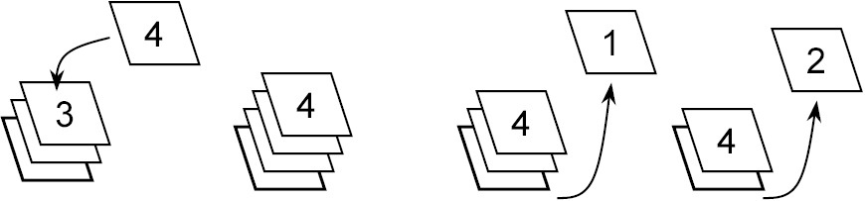
Queues - Principles
First In First Out (FIFO)
As opposed to last in first out (stacks)
And also to priority queues (in which priorities may not reflect the actual order of addition)

Slide 40
Queue Operations
You must always remove the element that has been in the queue the longest.
The operations are thus:
Add an element to the queue
Remove the element added the longest time before
Check whether the queue is empty.

Slide 41
A Queue ADT
public interface Queue {
// Is the queue empty?
boolean isEmpty();
// Add an element to the queue
void enqueue(int elt);
// Remove and return the earliest element of
// the queue
int dequeue();
}

Slide 42
A Stack ADT (from last lecture)
// a stack of integers
public interface Stack {
// is the stack empty?
boolean isEmpty();
// add (push) an element into the stack
void push(int elt);
// remove and return the most recently pushed
// element still in the stack
int pop();
}

Slide 43
Extending Arrays & Amortised Complexity

Slide 44
Extending arrays by relocate-and-copy
Because size is unpredictable:
initial array allocation may fall short
trying to be safe is wasteful
A solution: extensible arrays
start with a small array
if more space is needed, create a new, larger array and copy elements into it
... adds O(n) to space and O(n) to time per extension

Slide 45
Stacks with relocate-and-copy
public class ArrayStack implements Stack {
private int count = 0;
private int[] data = new int[1];
public boolean isEmpty() {
return count == 0;
}
public int pop() {
count--;
return data[count];
} ... continues

Slide 46
Stacks with relocate-and-copy (ctd.)
... which was the same as last week. However:
public void push(int elt) {
if (count == data.length) { // not enough space
int[] d1 = new int[data.length + 1]; // new
for (int i = 0; i < count; i++) // array
d1[i] = data[i]; // copy elements
data = d1; // use new array
}
data[count] = elt; // add new element
count++;
}
}

Slide 47
Amortised Analysis
Amortised complexity refers to the average complexity over a sequence of operations, which normally depend on each other (usually choosing the worst case regarding data input).
This is different from what we normally call average case complexity, which averages over different input data for a single, independent operation.
E.g., the average complexity (on an array of length n) of Quick Sort is O(n log n), the amortised complexity over a sequence of Quick Sort applications is O(n²)
(implying the worst case per application).

Slide 48
Analysis of the implementation
In a sequence of n pushes, the number of copies is
1 + 2 + 3 + ... + (n - 1) = n(n - 1)/2 = O(n²)
This means that per push operation, there is an amortised cost of O(n).
Going up by a larger step than 1 improves things, but
only by a constant factor.

Slide 49
… An improvement
If we double the size whenever we extend, the
number of elements copied for n = 2^{k} pushes is
1 + 2 + 2² + ... + 2^{k-1} = 2^{k} - 1 = O(n) (curious reader see proof on next slide)
This averages out at O(1) per operation, i.e., the amortised cost over the sequence of operations is constant.

Slide 50
Proof: Sum of Powers of 2¹
This has been used in the last analysis and the telescopic sum.
Statement: Σ_{i=0...k-1} 2^{i} = 1 + 2 + 2² + ... + 2^{k-1} = 2^{k} - 1
Proof by in induction:
base case k=2: 2⁰ + 2¹ = 1 + 2 = 3 = 4 – 1 = 2² – 1
step k to k+1: 2⁰ + ... + 2^{k-1} + 2^{k} = 2^{k} – 1 + 2^{k}
= 2·2^{k} – 1
= 2^{k+1} – 1
Statement
applied here
1. You don’t need to know this.

Slide 51
Array-like operations in extensible arrays
Some O(1) time operations in extensible arrays:
public int size() {
return count;
}
public int elementAt(int pos) {
return data[pos];
}
public void setElementAt(int pos, int value) {
data[pos] = value;
}

Slide 52
Summary of extensible arrays
They provide array-like operations at O(1) time
Extensible arrays when implementing the Stack ADT
Use O(n) space
With the right extension policy, all basic operations take O(1) time

Slide 53
FYI - Extending Arrays in Java

Slide 54
Extensible arrays in Java
Java has data structures for extensible arrays: Vectors and ArrayLists
Vectors and ArrayLists are like arrays that can be extended as necessary
you don’t have to worry about their size
you don’t have to extend them explicitly
Vectors have Objects as elements

Slide 55
ArrayLists in Java
Import them:
import java.util.List; // ArrayList and Vector are Lists
import java.util.ArrayList;
Create an ArrayList a1:
List a1 = new ArrayList();
Programming against an Interface is more flexible.
Adding at index i moves following elements to the right:
a1.add(i,p)
(Array)List and Vector use Generics since Java 5.0 (JDK 1.5):
List<String> stringList = new ArrayList<String>();

Slide 56
Vectors in Java
To use them you have to import them:
import java.util.Vector;
To create a vector v1:
Vector v1 = new Vector();
The size of vector v1 is:
v1.size()
To test whether v1 is empty:
v1.isEmpty()

Slide 57
Other vector & arrayList methods in Java
To add an element--object p--at the end of vector v1 (arrayList a1):
v1.addElement(p); a1.add(p);
To access the element at position n in vector v1 (arrayList a1):
e_n = v1.elementAt(n); e_n = a1.get(n);
To assign element p to position n in vector v1 (arrayList a1):
v1.set(n, p); a1.add(n,p);

Slide 58
Reading
Weiss: Chapters 15, 17 and 20
Drozdek: Sections 4.2, 6.1 and 9.3.2
Next week: Linked lists

Slide 59
Department’s contact info
City St George’s, University of London
Northampton Square
London
EC1V 0HB
United Kingdom
T: +44 (0)20 7040 6051
E: ug.cs@city.ac.uk
www.city.ac.uk/about/schools/science-technology/computer-science

